Slide 1
Deriving
Abstract Factory
Loosening the coupling
when creating objects...

Slide 2
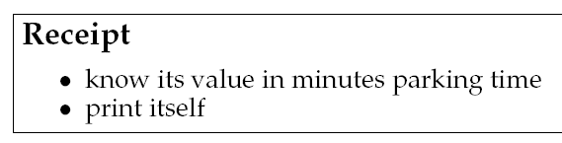
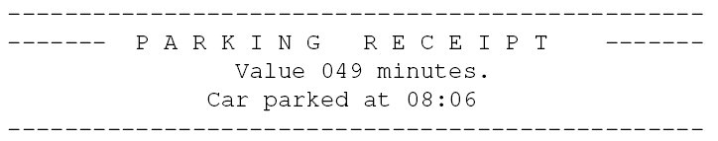
Prelude
The Receipt class revisited
  Add responsibility to print itself
  Provided by method
  Result:
Demo: code-demo/PayStationWithGUI

Slide 3
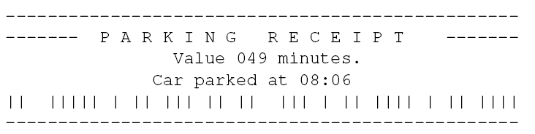
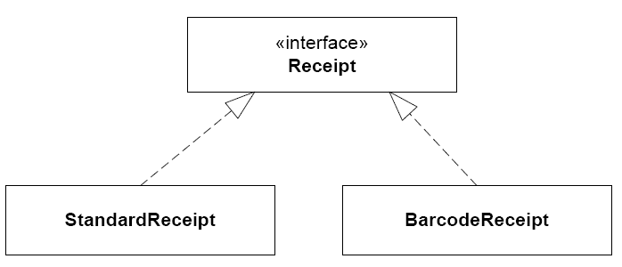
BetaTown
Change is the only constant in software dev.
Receipts with bar code for easy scanning

Slide 4
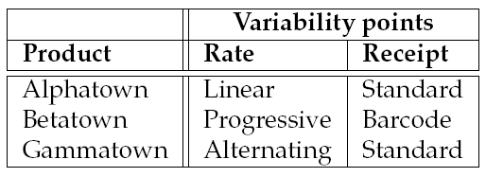
Yet another Variability
New variability point! Resulting configurations:

Slide 5
The Compositional Design

Slide 6
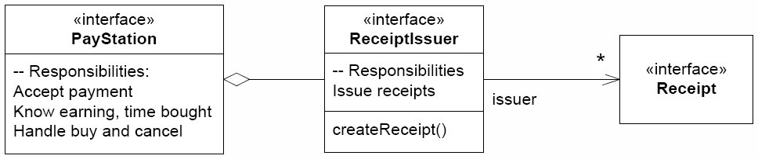
3-1-2
Cranking the 3-1-2 blindly
  3) Identify what varies: instantiation of receipts
  1) Interface express responsibility: ReceiptIssuer
  2) Compose behavior: delegate to ReceiptIssuer

Slide 7
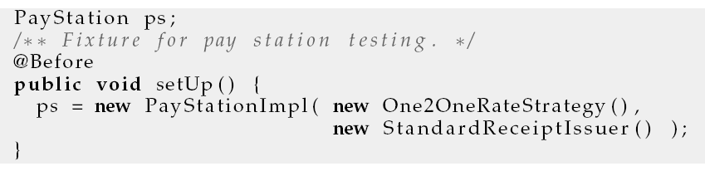
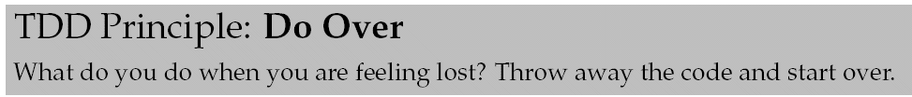
Trying it out
Quickly add a test:
Low cohesion: object creation in two different objects – why not make one cohesive object???

Slide 8
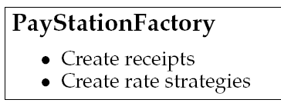
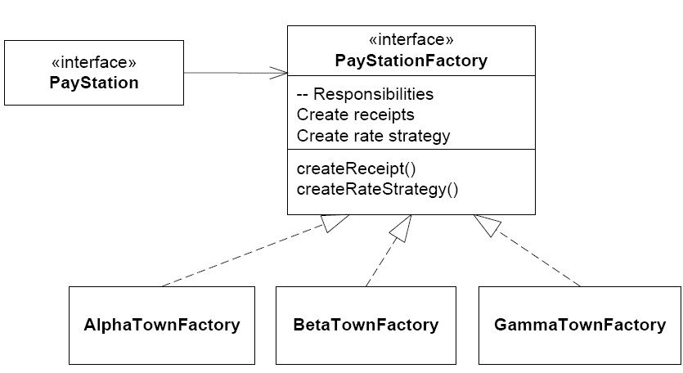
More Cohesive Design
One place to “make configuration objects”

Slide 9
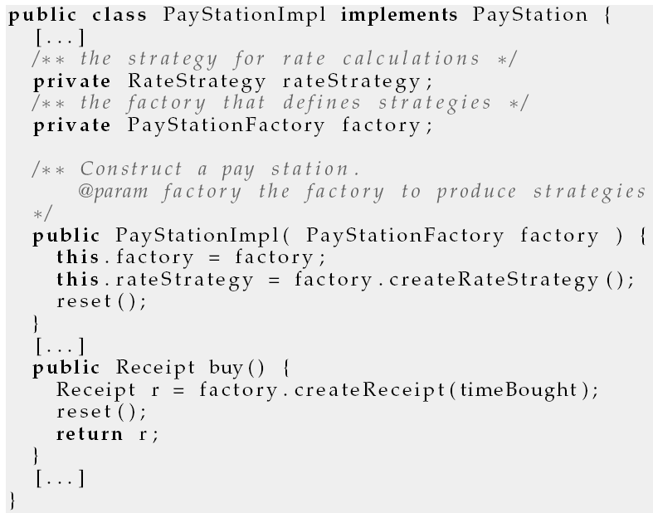
Usage

Slide 10
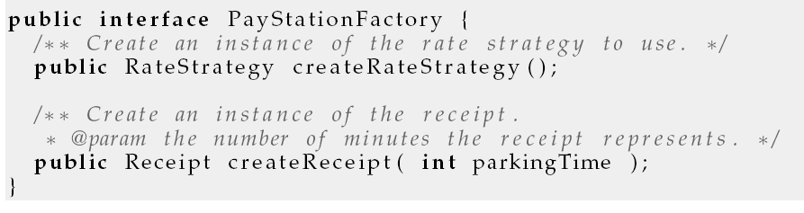
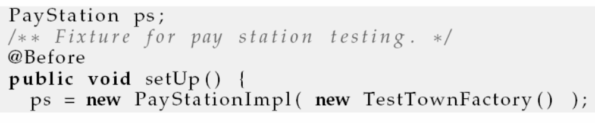
Why TestTownFactory()?
Notes:
Because I use a One2OneRateStrategy()

Slide 11
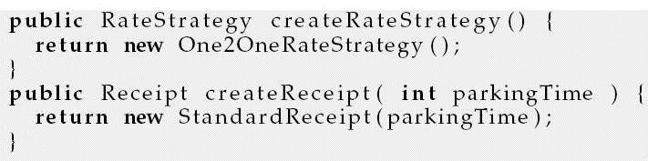
TestTownFactory

Slide 12
The Compositional Process

Slide 13
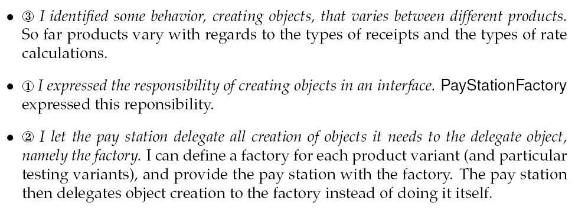
The Process Again Again

Slide 14
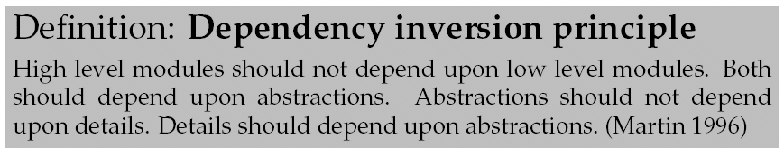
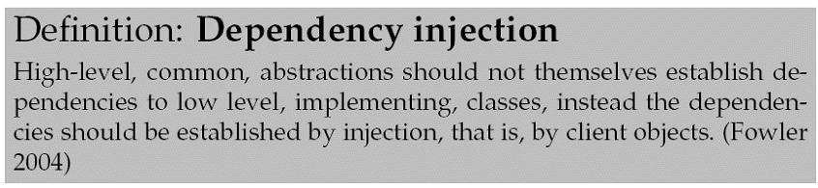
Or…

Slide 15
Abstract Factory

Slide 16
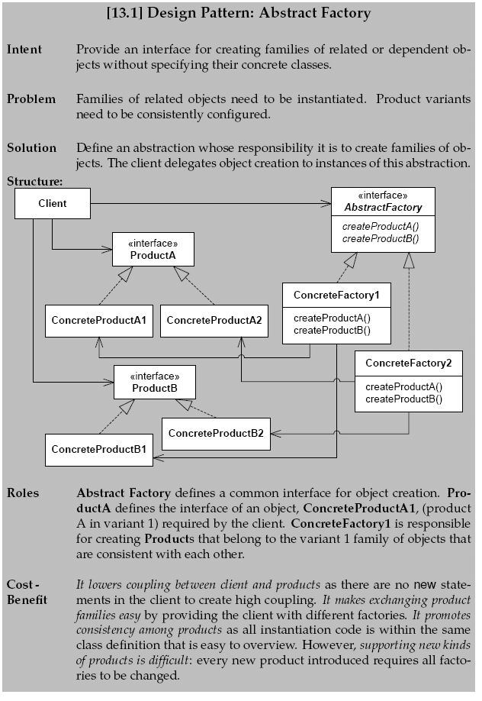
Deriving it…
3-1-2 has derived yet another design pattern
  An object (factory) whose responsibility it is to create objects (products) that the client need.

Slide 17
Deriving it…

Slide 18
Mandatory Note
Abstract Factory is complex
  Lots of relations
  Easy to get confused or miss the whole idea
  Easy to misimplement a little with BIG consequences
Morale
  Do not underestimate it…

